Slide 1

RUNGTA COLLEGE OF DENTAL SCIENCES & RESEARCH
TITLE OF THE TOPIC: Composites
DEPARTMENT OF CONSERVATIVE DENTISTRY AND ENDODONTICS

Slide 2
Specific learning Objectives
At the end of this presentation the learner is expected to know
Core areas* H | Domain ** | Category #
Definition, indication, contraindication, composition, Classification | Cognitive | Must know
Cavity preparation, clinical procedure, bonding agent | Psychomotor | Nice to know
Methods of polymerization | Affective | Desire to know
*Subtopic of importance
** Cognitive, Psychomotor or Affective
# Must know , Nice to know & Desire to know

Slide 3
Table of Content
What are composites
Definitions
Indications
Contraindications
Advantages
Disadvantages of dental composites.
Components of composites

Slide 4
CLINICAL PROCEDURE

Slide 5
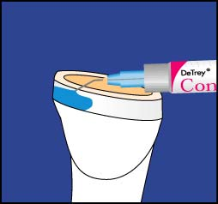
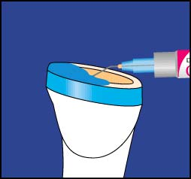
Etching
Increases retention by phosphoric acid (~ 37%)
Enamel
Produce micro-porosities
Increases contact areas
Dentin
Removal of smear layer / open up dentinal tubules
Min.
15 sec.
Max 15 sec.
Start at Enamel
Extend to Dentin

Slide 6
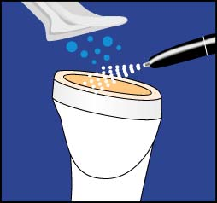
Remove Gel and excess water
Rinsing
To remove all acid remnants & tooth debris for successful bonding
15 sec.
Drying
Use oil-free air
Avoid desiccation of dentin
Etched surface must be kept free from contamination
“Dried” enamel surface should appear chalky white
Do not dessicate

Slide 7
Mechanical bond to tooth surface with adhesive system and surface roughness
Bonding to Tooth structure
Enamel:
Etching to create surface roughness → increased surface
Dentin:
Etching to remove smear layer → open dentinal tubules
Adhesive systems → bonding flow into DT to form resin tags

Slide 8
Placement Techniques
Bulk technique
Incremental placement technique
Horizontal placement technique
Oblique technique
Successive cusp build up technique
Stratified layering technique

Slide 9
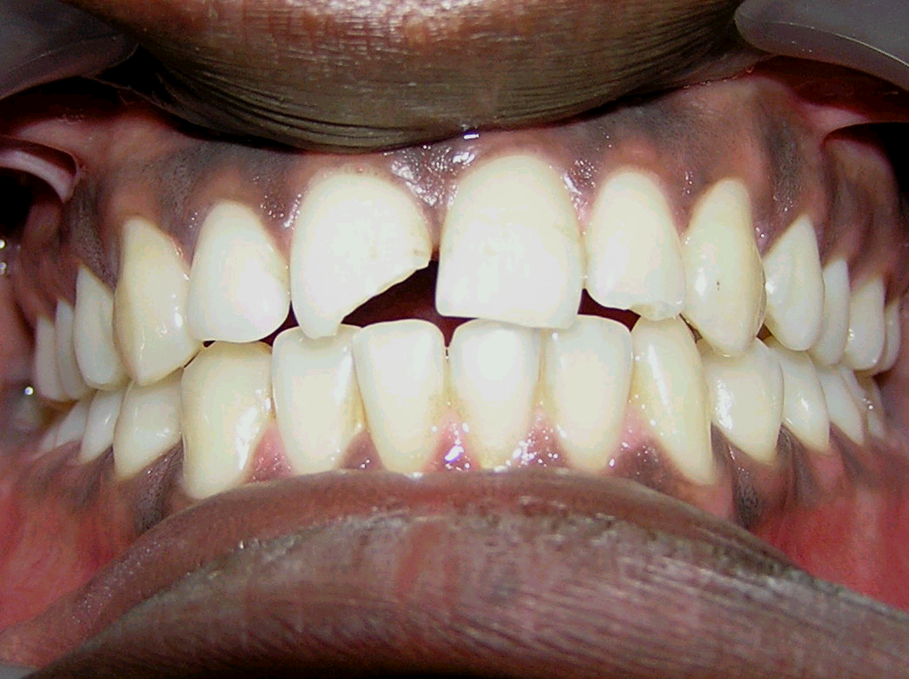
COMPOSITE restoration case report. PRE OPERATIVE:

Slide 10
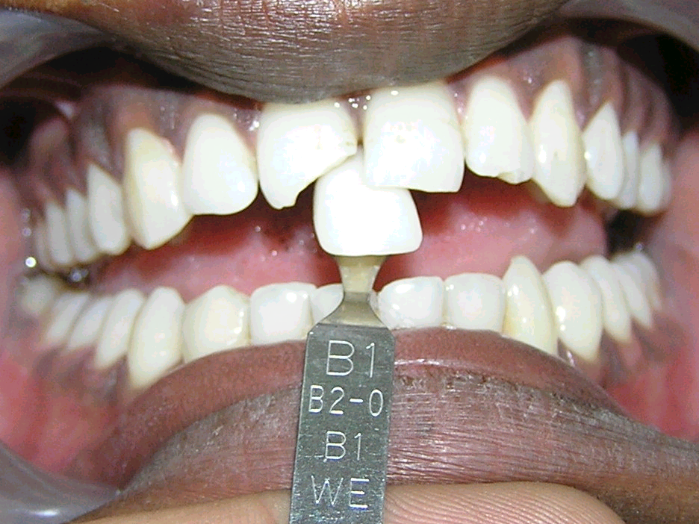
STEP I; Shade selection

Slide 11
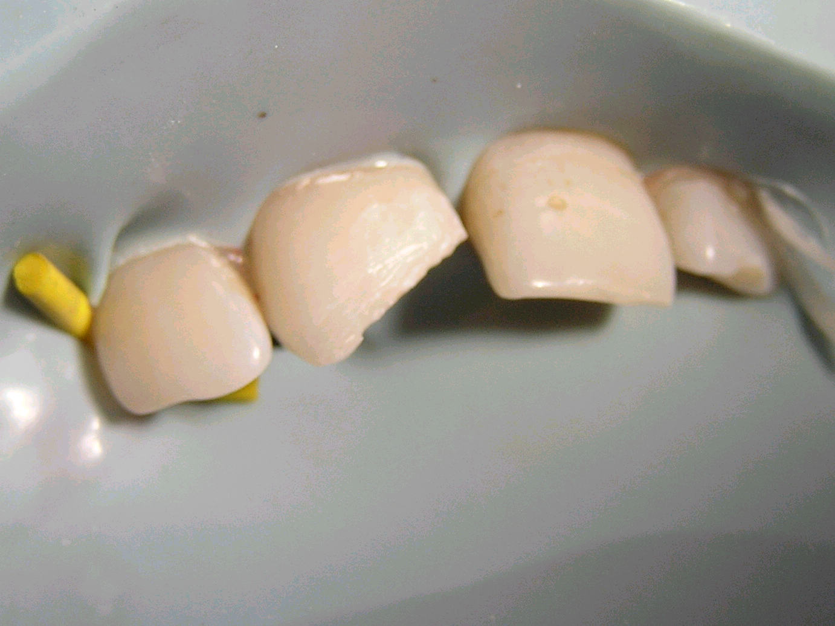
Step ii; beveling of the cavity

Slide 12
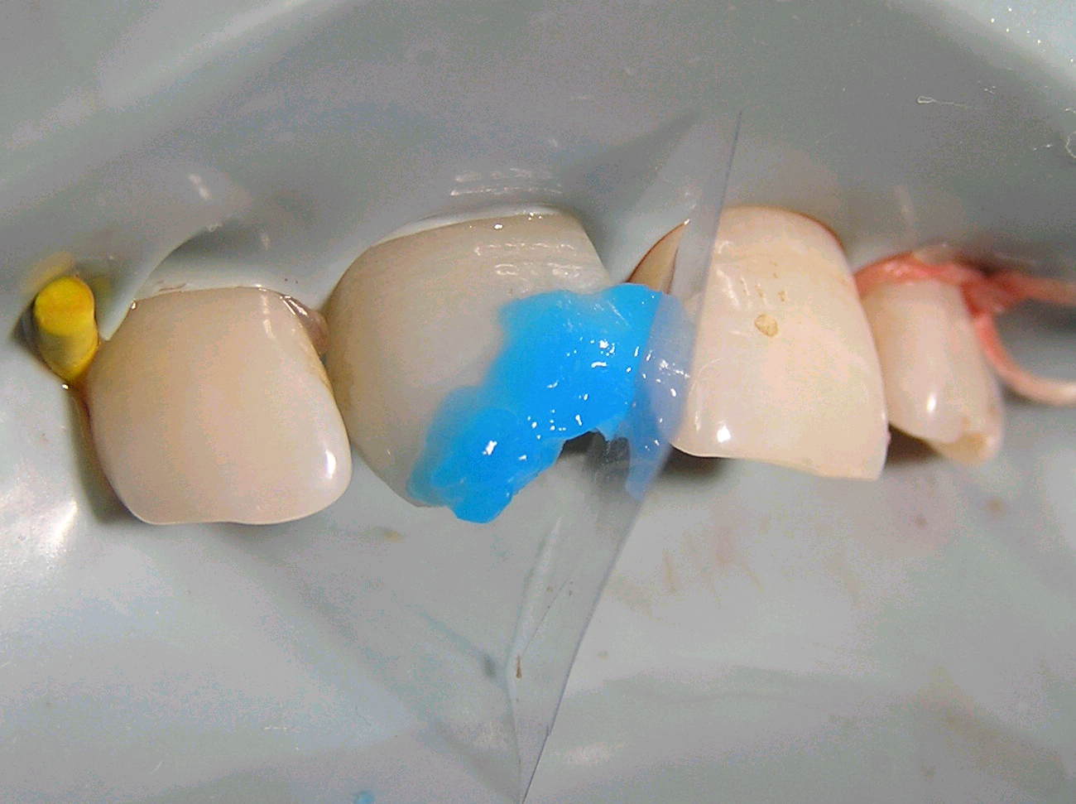
Step iii: Etching of the prepared surface for 20 sec,

Slide 13
Step iv:
Washing of Etchent with water and drying of the cavity.

Slide 14
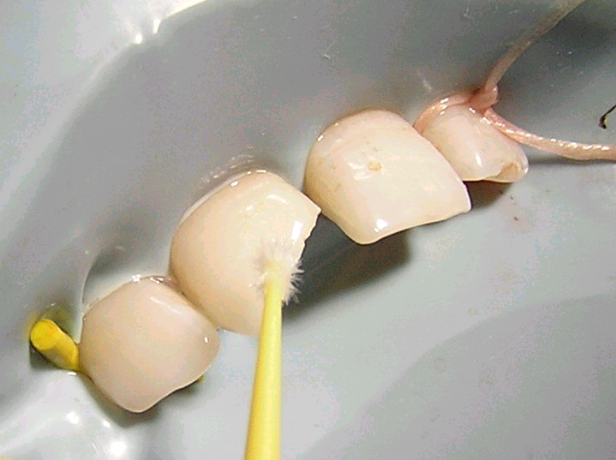
Step v: Application of bonding agent & curing for 20sec.

Slide 15
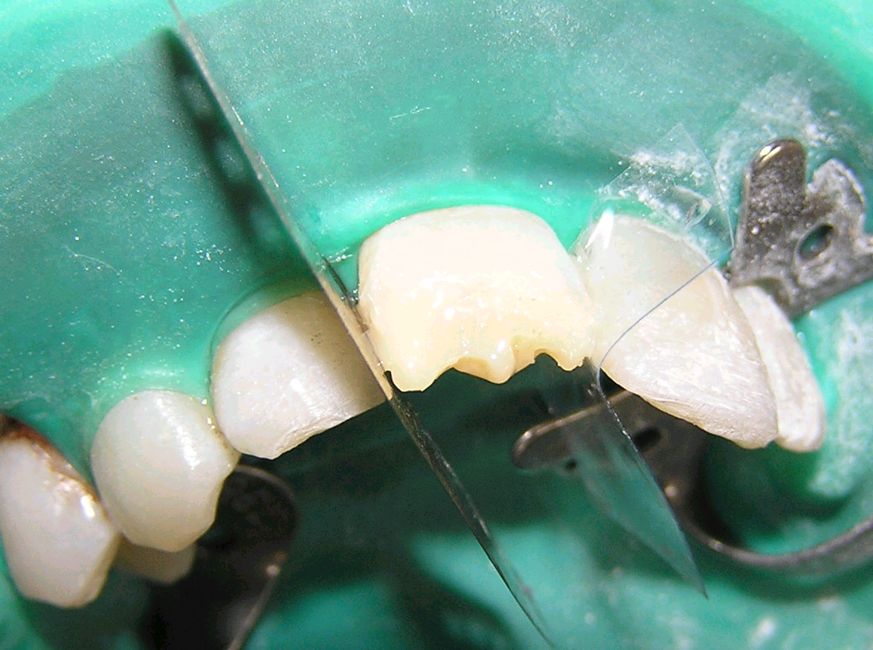
Placement of composites:
Layer by layer addition of composite to restore the defect.

Slide 16
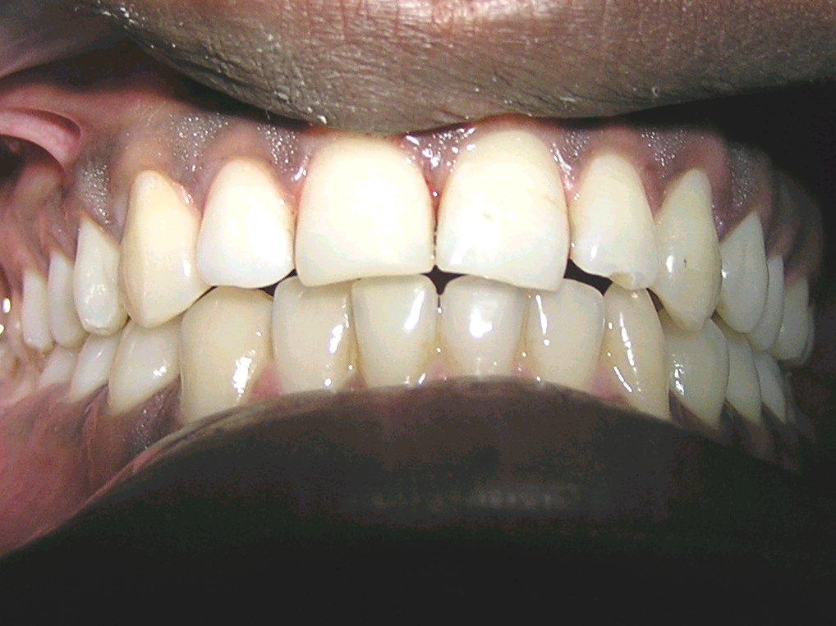
Final restoration before finishing & polishing:

Slide 17
PRE OPERATIVE VIEW

Slide 18
POST OPERATIVE VIEW

Slide 19
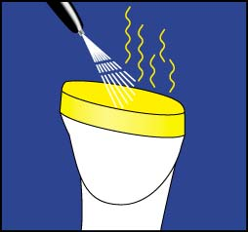
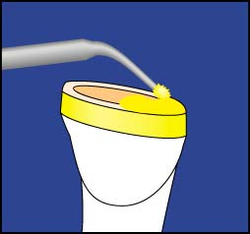
Bonding
Use low viscosity resin which will flow into etched enamel pores & dentinal tubules to form resin tags
Act as intermediary between tooth and composite
Apply ample amounts, leave undisturbed
Remove solvent with air-syringe
20 - 30
sec.

Slide 20
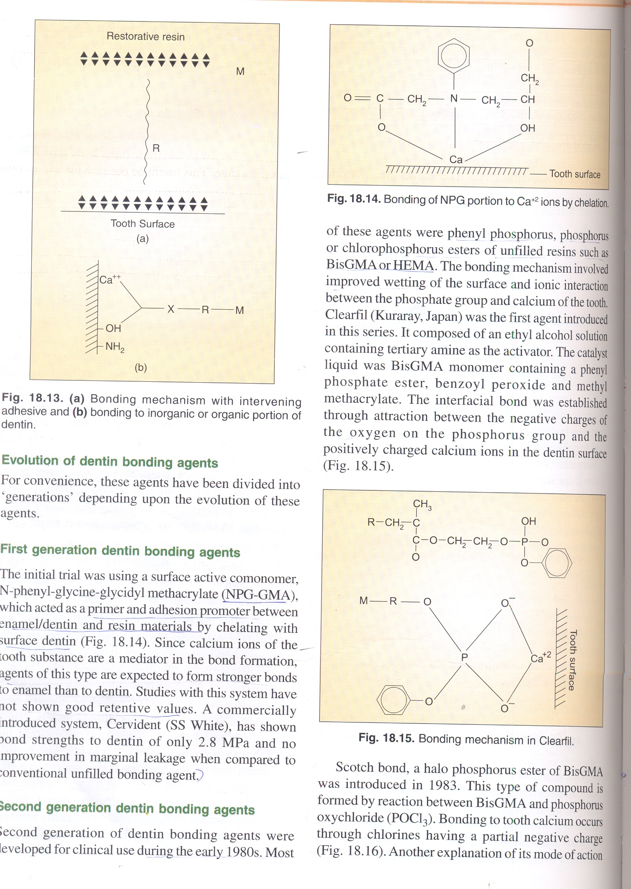
On the basis of generations
First generation dentine bonding agents
N-phenyl-glycine-glycidyl methacrylate ( NPG-GMA)
Acts as primer & adhesion promoter between enamel/dentin & resin.
Bonding-- chelation

Slide 21
Disadvantages of 1st generation
Lack of adequate bond strength.
As it is hydrophobic in nature, close adaptation to the hydrophilic dentine could not be achieved.
Biocompatibility was not appropriate.
Instability of NPG-GMA in solution.
Bond strength to dentine only 2-3MPa.

Slide 22
Second generation
Developed in the early 1980s.
The agents used were—
BisGMA or HEMA.
Polyurethans.
Bonding– ionic bond to calcium by chlorophosphate group.
E.g.
Clearfil,Scotch bond,
Prismal universal bond.

Slide 23
DRAWBACKS :-
It is not possible to achive long lasting bond.
Biocompatibility was not appropriate.
Bond strnegth to dentin only 2.8 MPa

Slide 24
Third generation
This generation dentin bonding agent requires either removal or modification of the smear layer.
These agents used a conditioning step on the dentin in conjunction with a bonding agent.
Three steps---
conditioning.
Priming.
Application of bonding agent.

Slide 25
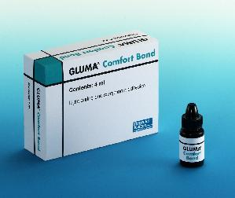
Oxalate
First available 3rd generation dentin bonding system.
Gluma
Scotchbond
Other agents of this generations –
Xrbond,prisma universal,clearfil,liner

Slide 26
Drawbacks in third generation bonding agents
Retention decreases with time.
The resin did not penetrate through the smear layer.
Increased chair side complexity.
More time consuming.
Technique sensitive.

Slide 27
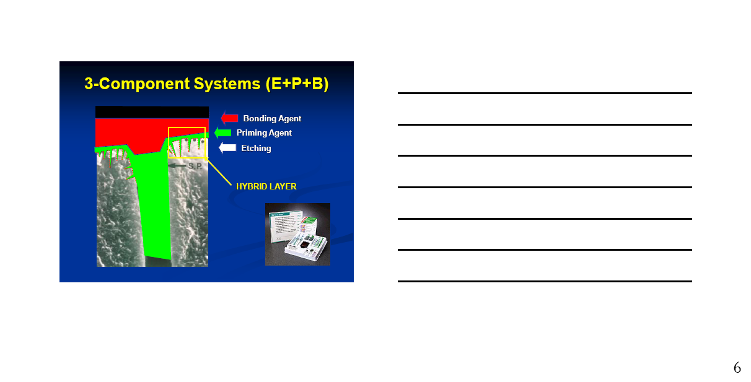
Fourth generation
Based on concept of hybridization for attaining attachment.

Slide 28
HYBRIDIZATION
This concept was proposed by Nakabayashi in 1982.
The diffusion & impregnation of resin into partially decalcified dentine followed by polymerization created a resin reinforced layer or HYBRID LAYER.
Definition :-
The structure formed in the dental hard tissue by demineralization of the surface & subsurface followed by infiltration of monomers & subsequent polymerization.

Slide 29
Advantages
Reduced technique sensitivity.
Similar bond strengths to enamel & dentin.
No reduction in bond strength when applied to moist surface.
Some systems can bond to mineralized tissue, metal, amalgam, porcelain,indirect composite restorations.

Slide 30
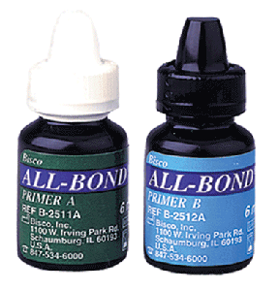
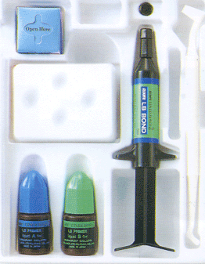
e.g.
Clearfil Linear Bond 2
All-Bond-2

Slide 31
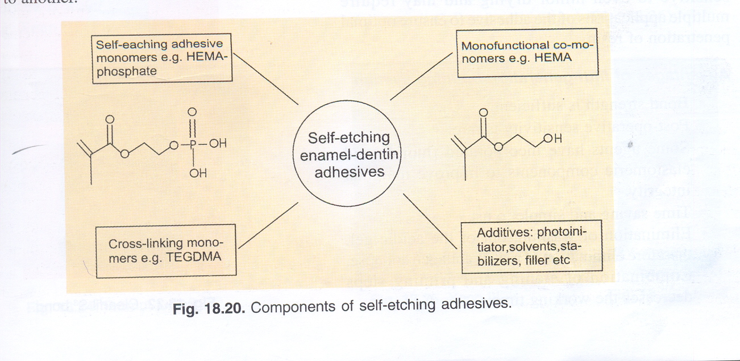
Fifth generation
This generation also based on concept of hybridization & rely on the wet bonding technique.
One component resin. (priming & bonding steps combined)

Slide 32
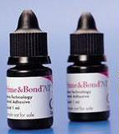
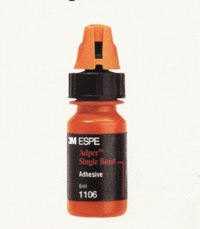
e.g.
Prime & Bond
Single bond

Slide 33
Advantages of fifth generation
One step.
Post operative sensitivity is rare.
Improved marginal integrity.
Combintion of etching & priming steps decreases the working time.
Elimination of washing out of the acidic gel, therefore elimination of risk of collagen collapse.

Slide 34
Sixth generation
All three components, etchant,primer,adhesive resin in a single solution.
Show less bond strength to enamel as compared to dentin.
TWO TYPES
Type 1 – self etching primer & adhesive Type 2 – self etching adhesive.

Slide 35
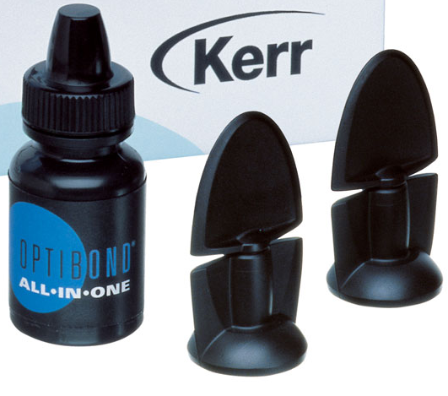
Type 1 (self-etching primer & adhesive)
Two bottles, Liquid 1(acidic primer)
Liquid 2(adhesive)
e.g.Nano Bond,0ptibond,Prompt L-pop

Slide 36
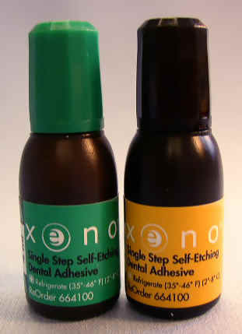
Type 2 (self-etching adhesive)
Two bottles, containing acid primer & adhesive
A drop of each liquid is mixed & applied.
e.g. XENO III

Slide 37
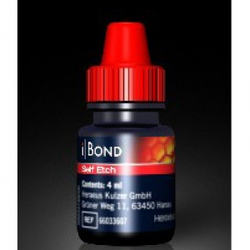
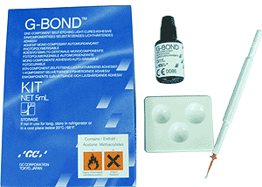
Seventh generation
These are modifications of type 2 sixth generation bonding agents.
Single bottle system.
Unprepared enamel require etching with phosphoric acid.
The formulation is light cured.
e.g. G-Bond, i-Bond

Slide 38
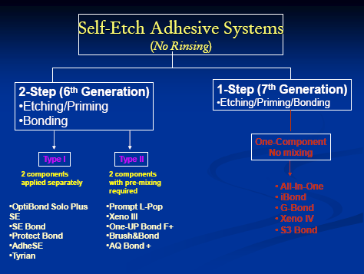

Slide 39
REASONS FOR POPULARITY
Meets the patient’s instant esthetic demand.
Provides satisfactory longevity.
Permits the most conservative approach to cavity preparation.
Optimally restore the morphology & the original mechanical resistance of the tooth to resume proper function.
Ensures proper adaptation & seal of restoration to prevent reccurent decay, pulpal injuries & dentinal sensitivity.
Biologically compatoble with underlying vital substrate.
Harmonious with adjacent tissues.

Slide 40
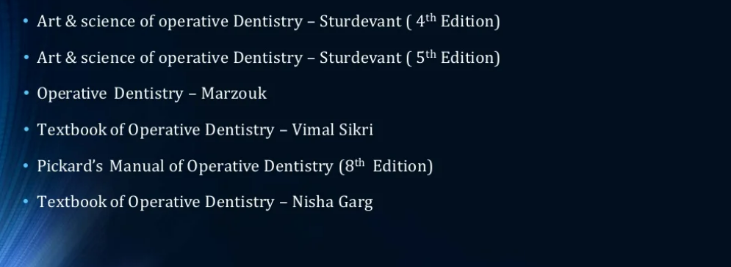
Teaching Materials

Slide 41
TAKE HOME MESSEGE/ FOR THE TOPIC COVERED (SUMMARY)
There is a wide scope of composite material in automotive, aerospace, wind energy, electrical, sports, domestic purpose, civil construction, medical chemical industries etc. Composite materials have a great potentiality of application in structures subjected primarily to compressive loads.
Composite materials have attractive aspects like the relatively high compressive strength, good adaptability in fabricating thick composite shells, low weight, low density and corrosion resistance.
Composite materials have good mechanical, electrical, chemical properties, due to which we can use composite material in many various industries.

Slide 42
Question & Answer Session
Steps in clinical procedure of composite?
Describe generations of bonding agent?

Slide 43
REFERENCES

Slide 44
THANK YOU

